Slide 1

Contents:
EC2 Instance Life Cycle
Provisioning an Instance
Instance Types
Placement Groups
User data

Slide 2
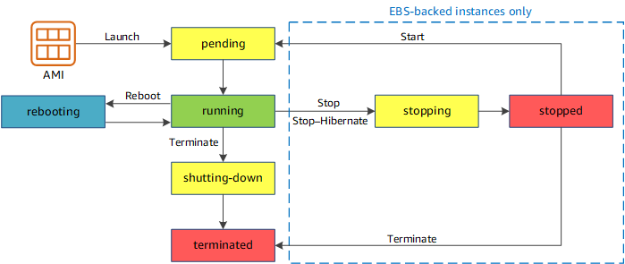
EC2 Instance Life Cycle
The moment you launch an EC2 Instance, it transits through different states.
Pending :Instance launch, not billed.
Running :start, billed.
Stopping :preparing to stop, not billed, charge for the storage for any Amazon EBS volumes.
Stopped :not billed.
shutting-down: preparing to terminate.
Terminated

Slide 3
Start and Stop
When an stopped instance is started, it enters the pending state, and the instance is moved to a new host computer (though in some cases, it remains on the current host). And will lose any data on the instance store volumes on the previous host computer.
But, Retains its private IPv4 address. And even IPv6.
Hibernate Instance
Hibernating, no data is loosed, billed for EBS volume.
Works same as start and stop.
Instance Reboot
Rebooting, nothing is changed, just like restarting laptop.
Instance Termination
Permanently deleting.

Slide 4
Provisioning an Instance
Requirement or steps for Launching an Instance.
Open the Amazon EC2 console
AWS Region
From the Amazon EC2 console dashboard, choose Launch instance.
Name and tags, for Name, enter a descriptive name for your instance.
Under Application and OS Images (AMI), choose Quick Start, and then choose OS for instance.
Under Instance type, choose instance type.
Under Key pair (login), for Key pair name, choose an existing key pair or create a new one.
Under Network Setting, Edit required and create Security group or select existing one.
Configure Storage
Go with Advanced setting, if required
In the Summary panel, choose Launch instance.

Slide 5
Instance Types
General Purpose : t2, m5
Compute-Optimized : high compute power rather than memory, high CPU to memory ratio. (c4 c5, c6)
Memory-Optimized : for memory intensive operations, specially database. ( R4, r5 and r6 family)
Storage-Optimized : Storage optimized EC2 instances are used to support high I/O work load such as parallel processing or MPP data warehouse. (d2,d3,h1,i3)
Accelerated Computing : It provides compute capacity for very high performant machine learning and scientific workloads that cannot be accommodated within the CPU alone. These workloads can be supported by external hardware like GPU

Slide 6
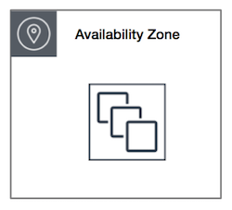
Placement Groups
When instance is created it is spread out across underlying hardware to minimize this correlated failures.
To meet the needs of our workload we can place group of interdependent server based on below strategies.
Cluster : Logical grouping of instances within a single Availability Zone.
Can span peered VPCs in the same Region.
Placed in the same high-bisection bandwidth segment of the network.
*for applications that benefit from low network latency, high network throughput, or both.

Slide 7
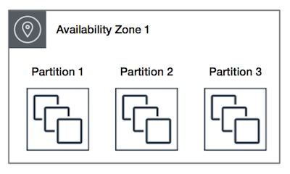
Partition placement group:
EC2 divides each group into logical segments .
Each partition within a placement group has its own set of racks.
Each rack has its own network and power source.
*used to deploy large distributed and replicated workloads

Slide 8
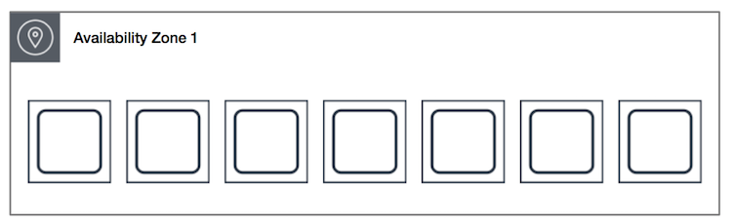
Spread Placement Group:
A spread placement group is a group of instances that are each placed on distinct hardware.
* reduces the risk of simultaneous failures

